Slide 1
Staying In control: Your brain and the effects of drugs
Notes:
The following slides are divided into two parts. A summary of the brain parts and their functions and what drugs do to the brain (and other parts of the body).
Your students are not old enough to remember the commercial about the egg and the frying pan. Share that with them.

Slide 2
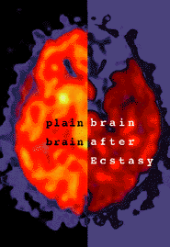
First we’ll talk about the normal brain…
…then we’ll talk about the brain on drugs

Slide 3
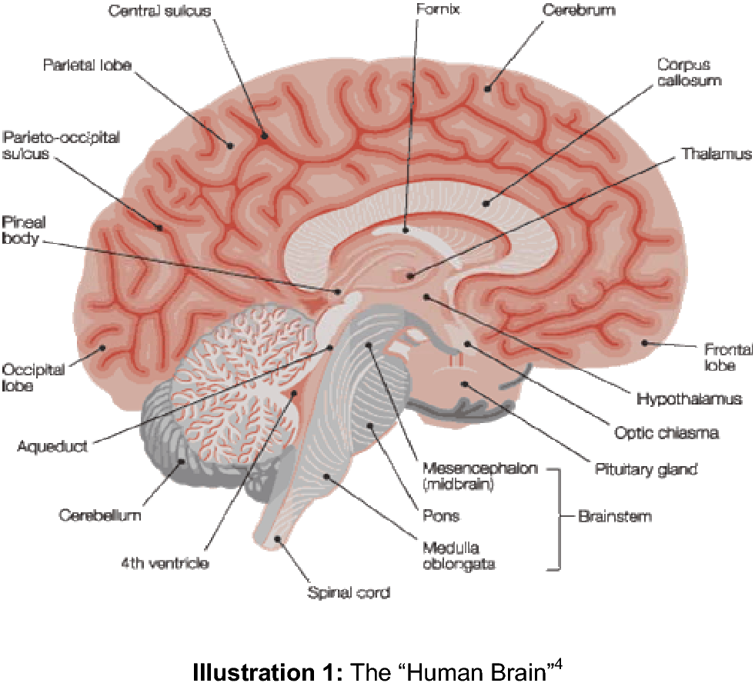
The VIPs of Brain Function
Notes:
The intent of the slides about the brain is to make the point to your students that in order to have control over one’s body, the brain must be functioning well. In later slides, when drugs are discussed, there will be mention of what part of the brain is affected – and therefore what controls are lost.

Slide 4
The Human Brain
The Brain Stem
Connects the brain and the spinal cord.
Controls many basic functions:
Heart rate
Breathing
Eating
sleeping

Slide 5
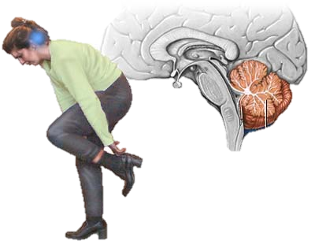
The Human Brain
The Cerebellum
Coordinates the brain’s instructions for skilled, repetitive movements and for maintaining balance and posture
Notes:
The cerebellum is the reddish part just behind the brain stem.

Slide 6
The Human Brain
The Limbic System
(e.g. amygdala and hippocampus)
Control emotions and motivations, particularly those related to survival:
Fear
Anger
Sexual behavior
Also involved in feelings of pleasure (example: eating)

Slide 7
The Human Brain
The Diencephalon contains the thalamus and hypothalamus.
Thalamus – involved in sensory perception and regulation of motor functions
The Hypothalamus regulates:
Feeding hormones
Pituitary gland
Body temperature
Adrenal glands
And many other vital activities

Slide 8
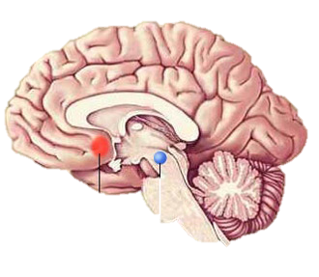
The Human Brain
Nucleus Accumbens
Plays a central role in the “reward circuit”.
VTA (Ventral Tegmental Area)
One of the primitive parts of the brain
Involved in the mechanisms of pleasure

Slide 9
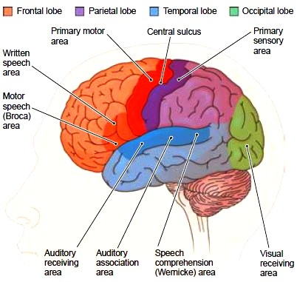
The Human Brain
The Cerebral Cortex
Approximately 2/3 of the weight of the brain
Most highly developed part of the brain
Responsible for
Thinking
Perceiving
Language (both speaking and understanding the spoken word)

Slide 10
Now…the effects of drugs

Slide 11
Marijuana
THC (tetrahydrocannabinol) is the main ingredient in marijuana that causes users to experience a calm euphoria.
THC interferes with the normal functioning of
The cerebellum (balance, posture, coordinated movement)
hippocampus (involved in memory formation)
cerebral cortex (receiving sensory messages, i.e., touch, sight, hearing, taste and smell)
Notes:
Research studies indicate that marijuana may lead to permanent memory impairment.
Recent studies on animals indicate that the withdrawal effects of marijuana are similar to those of other major drugs (i.e. cocaine, heroin and alcohol.)

Slide 12
Opiates
Derived from the poppy plant and have been used for centuries to relieve pain.
Examples: opium, heroin, morphine, and codeine.
Opiates activate the brain’s reward system (VTA, nucleus accumbens, and cerebral cortex), causing an intense euphoria that lasts only briefly, but is followed by a few hours of a calm and relaxed state.

Slide 13
Opiates (continued)
Excessive amounts of an opiate can cause breathing to slow down and stop altogether.
The brain produces endorphins which help to relieve or control pain. Sometimes when pain is severe, the brain does not make enough endorphins to provide pain relief. Opiates have been used by physicians for years without causing additictions.
Notes:
Ask the class why a physician can give morphine for pain in the hospital, and the patient does not become an addict?
(Answers: appropriate amount given, not for extended period of time, well monitored, typically not given to the patient when he/she leaves the hospital.)

Slide 14
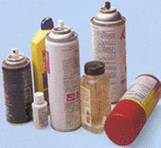
Inhalants
Most inhalants are common household products that give off mind-altering chemical fumes when sniffed.
It is known that vaporous fumes can change brain chemistry and may be permanently damaging to the brain and central nervous system.
Notes:
Examples:
Volatile solvents – glue, petrol
Aerosols – cigarette lighters, hair sprays, air freshener
Nitrous oxide (laughing gas)
Volatile nitrates – amyl nitrate and butyl nitrate
The chemical structures are so different, it is impossible to group them and make generalizations about what harmful effects they will have.

Slide 15
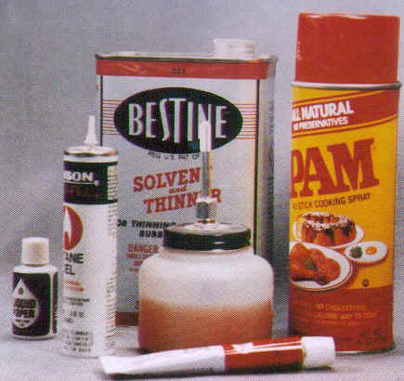
Inhalants (continued)
Sudden Sniffing Death (SSD) – inhalant replaces the oxygen in the lungs and the central nervous system. The user suffocates.
Use of inhalants can cause:
Disruption of the normal heart rhythm / cardiac arrest
Hepatitis
Liver failure
Muscle weakness
Anemia
Sleep problems
Drug cravings
Severe anxiety
Notes:
Chronic inhalant users may see a reduction in size of the cerebral cortex, cerebellum and the brainstem.
Myelin is a fatty tissue which insulates and protects the nerve cell and helps speed up conduction. Inhalants damage or destroy myelin which interferes with the flow of messages from one nerve to another.

Slide 16
Steroids
Anabolic Steroids are chemicals that are similar to testosterone.
While quite successful in body building, they can damage other organs in the body.
Steroids affect the hypothalamus and limbic system.
Notes:
Steroid use can decrease normal testosterone production in males and cause the loss of monthly periods in females.
Because they affect the limbic system (which regulates learning, memory and the regulation of moods) steroid users may experience aggressive or violent behavior, mood swings and impaired judgment.

Slide 17
Stimulants
Stimulants – Examples:
Cocaine
Amphetamines
Caffeine
Speed up activity in the brain and spinal cord
Notes:
Use of stimulants can cause the heart to be abnormally fast and also narrows blood vessels, reducing the flow of blood and oxygen to the heart.
Cocaine has been found to affect the pre-frontal cortex and amygdala which are involved in aspects of memory and learning. The amygdala has been linked to emotional aspects of memory.

Slide 18
Methamphetamine
Notes:
Teachers – Methamphetamine is also a stimulant, but so widely used now it deserves its own slide!
Cell damage can occur in the frontal cortex, amygdala and the striatum, a brain region that is involved in movement.
Short-term effects: wakefulness, increased physical activity, decreased appetite, increased respiration, hyperthermia, irritability, tremors, convulsions and aggressiveness.
Even short-term exposure to methamphetamine can cause issues that last for years

Slide 19
Tobacco
Nicotine – the main ingredient that acts in the brain and produces addiction
Notes:
Nicotine was isolated in 1828.
More recent research has shown that the addition to nicotine is as powerful or as strong as addictions to other drugs such as heroin and cocaine.
Ask the class what body functions change as a result of smoking.

Slide 20
Alcohol Abuse
The Cerebellum (responsible for coordinating movement) is the region most frequently damaged in association with chronic alcohol consumption.
Notes:
Effects of alcohol abuse: difficulty walking, blurred vision, slurred speech, slowed reaction times, impaired memory.
Blackouts and memory lapses
New studies show that women are more vulnerable than men to many of the medical consequences of alcohol use. Alcoholic women develop cirrhosis; alcohol-induced damage of the heart muscle, and nerve damage after fewer years of heavy drinking than do alcoholic men.
Studies on Alcohol-induced brain damage in men and women have yet to be conclusive.
Liver disease – Liver cirrhosis resulting from prolonged, excessive alcohol consumption can actually harm the brain. This is a disorder known as hepatic encephalopathy which can cause issues in one’s sleep patterns, mood, and personality (depression, anxiety, shortened attention span, etc.).

