Slide 1
Abstinence
Exploring the Effects of Teenage Sexual Behavior and Teenage Pregnancy

Slide 2
Consequences of Sex
Sexually Transmitted Infections (HIV, HPV, Herpes, Chlamydia, Gonorrhea, Syphilis)
Unintended Pregnancy
Emotional Distress
Social Challenges
Spiritual Conflict

Slide 3
Realities of Teen Moms
The following slides were created using information from an infographic created by www.deals.com

Slide 4
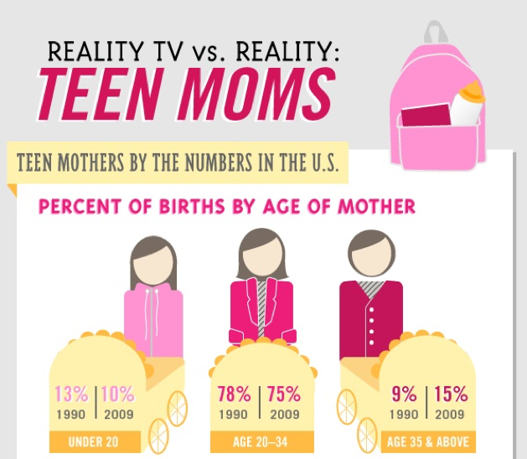

Slide 5
Reality “Check”
MTV reality moms may receive an average of $65,000 per season. Other famous teen moms have reportedly received large endorsement deals for books and speaking engagements.
The salary of an average teen mom:
Teen Mom
23,000.000
Annual Income

Slide 6
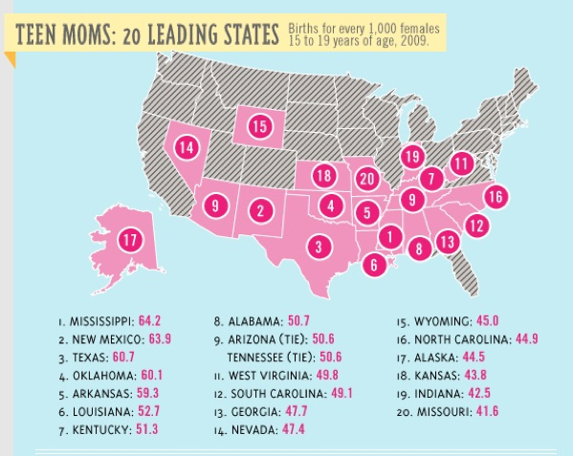

Slide 7
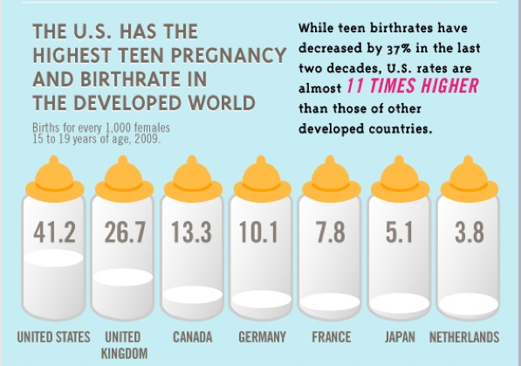

Slide 8
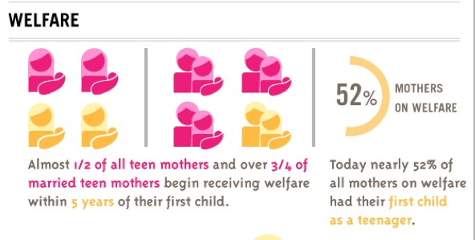

Slide 10
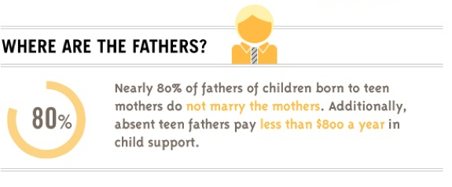

Slide 11
Sexually Transmitted Infections (STIs)
The CDC estimates there are 19 million new cases of STIs each year in the United States.
STIs cost the U.S. health care system 17 billion dollars each year.
Young people represent 25 percent of the sexually experienced population in the United States, but account for nearly half of new STIs.
(Source: CDC, 2012)

Slide 12
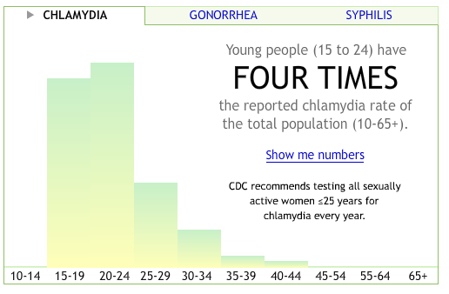
Click Here  to view other data visualizations of health disparities related to STIs. (CDC, 2012)

Slide 13
Choices
The choice of abstinence has known outcomes – prevention of pregnancy and disease.
The choice to have sex has risks and many possible life changing outcomes.

Slide 14
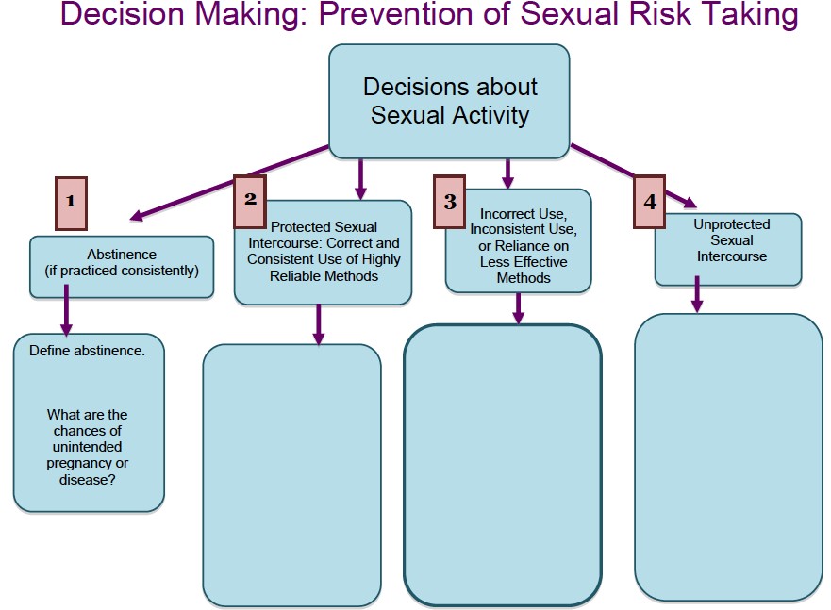
When Making Choices to Become or Remain Abstinent Use the Decision Making Process
Source: http://www.dpi.state.nc.us/acre/standards/support-tools/

Slide 15
Create An Infographic Promoting Abstinence
Use www.easel.ly/ to create an infographic providing data and supporting information that will explain why abstinence from intimate sexual behavior is the most effective method for preventing unintended pregnancy and disease.
The infographic must include:
Teen pregnancy data
STI data
Short term and long term consequences of unintended pregnancy and disease
Benefits of abstinence
Strategies supporting the decision to become or remain abstinent

Slide 16
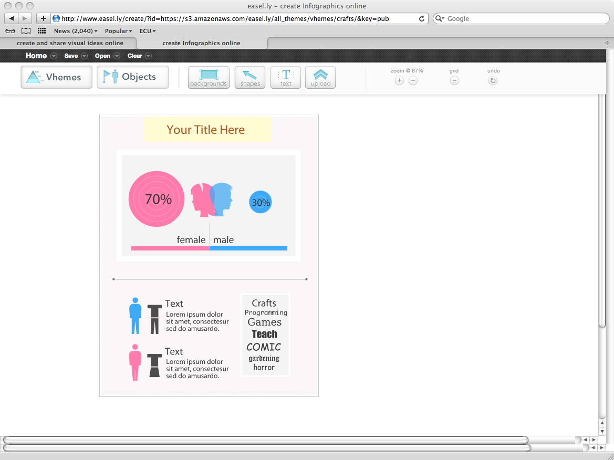
Infographic Example Template from www.Easel.ly/

