Slide 1
Spark Question!
Should the Unites states of America allowed athletes to compete in the Olympics due to the threat of the zika virus? Why or Why not?

Slide 2
Chronic or Communicable
Rhinovirus (Common Cold)
Malaria
Tuberculosis
Hepatitis
Influenza (The Flu)
HIV
Rabies
STD’s
Chicken Pox
Measles
Lyme Disease
Heart Disease
Cancer
Diabetes
Osteoporosis
Alcoholism
Parkinson’s Disease
Emphysema
Alzheimer’s Disease
Hemophilia
Epilepsy
Scoliosis

Slide 3
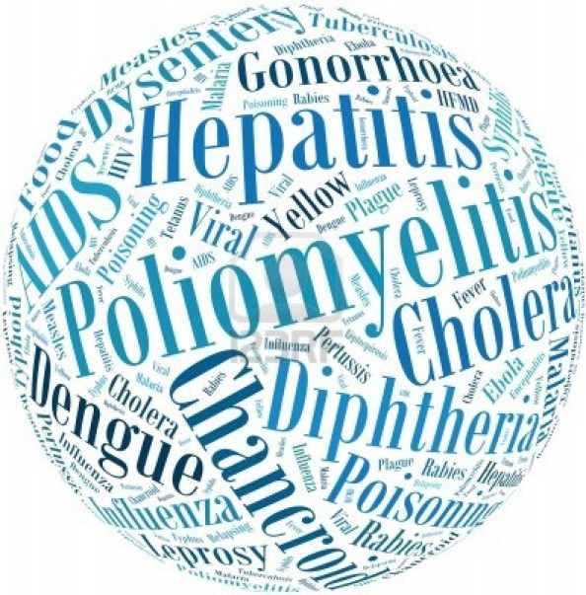
Chronic vs. Communicable Diseases
Two main types of disease that interfere with the quality of your life

Slide 4
What is the difference?
Communicable Diseases (Contagious)
Communicable diseases are often called infectious diseases and transmitted by another person or an animal, like a mosquito or tick.
Chronic Diseases (Lifestyle)
Chronic diseases are often called lifestyle diseases and usually caused by one’s lifestyle choices, like diet and nutrition, and worsen over time.

Slide 5
Then, Now, & The Future
THEN- Communicable diseases were the leading causes of death in the past (100yrs ago). Not as prevalent now.
Ex) Small pox, tuberculosis, influenza
NOW- Currently the diseases called chronic (or lifestyle) are the leading killers.
Heart disease, cancer, diabetes
FUTURE- The new challenge for scientists, doctors, and the public at large are “emerging infections.”

Slide 6
Infectious Disease Types
Infectious diseases are caused by germs.
Another word for a germ is a microbe.
Sometimes called a pathogen.
There are 4 main types of microbes.
Bacteria
Virus
Fungi
Protozoa
When there is a mass outbreak of a communicable disease it is often called an epidemic, and they are studied by epidemiologists.

Slide 7
How Diseases Spread
Direct Contact
Examples of Spread of Illness | How To Prevent
Stepping on a nail and getting tetanus | Receive tetanus vaccination and keep cuts clean
Exchange of bodily fluid (kissing, sneezing, etc.) and getting Mononucleosis | Cover your mouth when sneezing– Avoid kissing infected persons
An animal bite or scratch | Avoid animals unknown to you; seek medical care for animal bite

Slide 8
How Diseases Spread
Indirect Contact
Examples of Spread of Illness | How To Prevent
Contaminated objects Ex) school materials, doorknobs or things touched by someone who is ill | -Avoid touching your face or rubbing your eyes -Wash hands often
Other Organism Ex) mosquitoes, ticks, fleas, or flies | -Check body and clothing for parasites such as ticks when coming in from outside.
Contaminated food Ex) Poorly handled food or food not cooked well enough. | -Wash hands before cooking -Cook your food well -Keep cold food cold and hot food hot
Contaminated water Ex) Water from unclean sources or eating food prepared in unclean water. | -Do not drink from creeks, rivers or lakes

Slide 9
How Diseases Spread
Airborne Transmission
Examples of Spread of Illness | How To Prevent
Pathogens for flu and colds -Spread by coughing/sneezing | -Get a flu shot -Cough or sneeze in your arm

Slide 10
Chronic Diseases
Currently chronic diseases are the leading cause of death in our country. They develop because of risk factors such as heredity or lifestyle or a combination of both.
The top three causes of death by chronic disease – heart disease, cancer, stroke

