Slide 1
Communication Skills
“First learn the meaning of what you say, and then speak.”
-Epictetus

Slide 2
Communication
Communication is the clear exchange of ideas and information.
Whenever you communicate, you are sending or receiving a message.
Good communication is the root of all healthy relationships/friendships.

Slide 3
Types of Communication
Verbal Communication: On one end you have the speaker or writer and on the other end you have the listener or reader.
One part of good communication is being a good listener.

Slide 4
Types of Communication
Non-Verbal Communication: This involves your body language.
Ex) Facial expressions, eye contact, gestures, and posture
Mixed Messages are when your words don’t match your body language.
Different Cultural Perspectives
Being sincere or genuine

Slide 5
Communication Styles
Aggressive: Hostile and unfriendly in the way feelings are expressed.
Passive: Doesn’t speak up about their feelings or thoughts.
Assertive: You express yourself in a direct and respectful way.

Slide 6
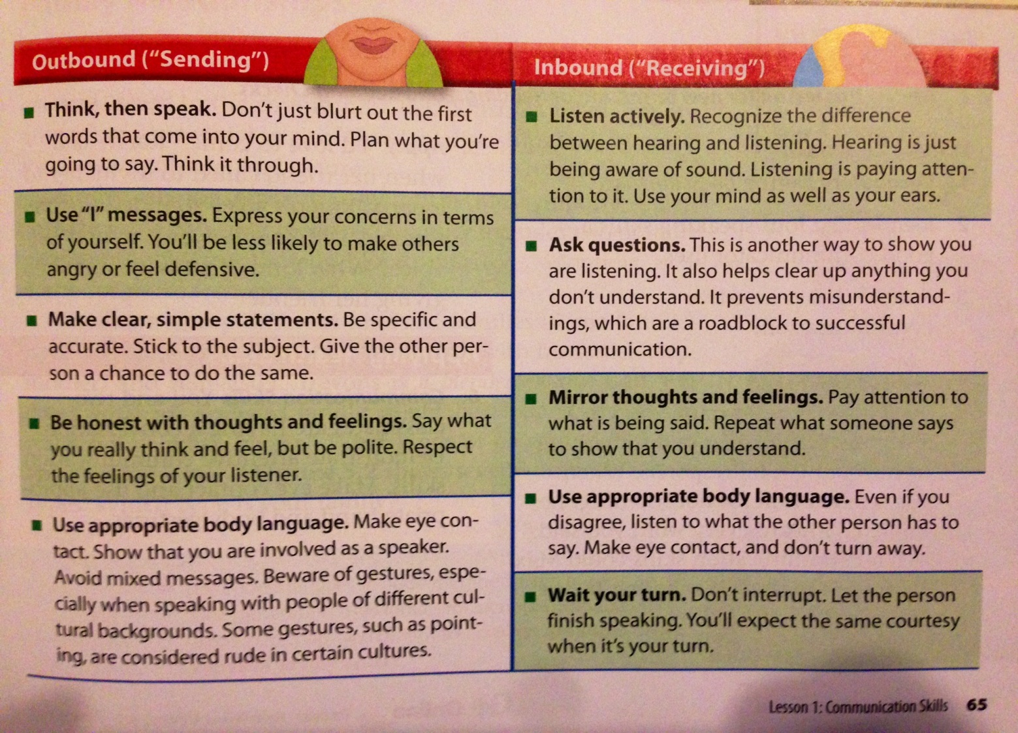
Good Communication Skills

Slide 7
I vs. You Messages
An I-Message is a strong and assertive way to express yourself without being mean or harmful.
A You-Message is the opposite. You express yourself by putting the focus on others and come off as mean and aggressive.

Slide 8
I vs. You Messages
An I-Message consists of 3 Steps:
Expressing your feelings using, “I”.
Describing the action that causes your feeling.
Explain how it affects you.

