Slide 1
Contraception
Evaluating FDA-Approved Contraceptive Methods

Slide 2
Contraception Options Functional Knowledge
What is it?
How does it work? (Method Type)
How do you get it? (Convenience)
Possibility of getting pregnant? (Effectiveness)
Associated health risks? (Risks)
Protection from disease? (STD Protection)

Slide 3
Points of Consideration When Selecting BC Methods
Individual’s health (liver disease, weight, smoker?, HBP, cancer risks, use of antibiotics, blood clot history etc)
How often individual has sex
How many sexual partners the individual has had
Are children desired in the future?
Financial costs
Accessibility (OTC or Rx only)
Efficacy rate – preventing pregnancy

Slide 4
Nearly Half of Pregnancies in the US are Unintended

Slide 5
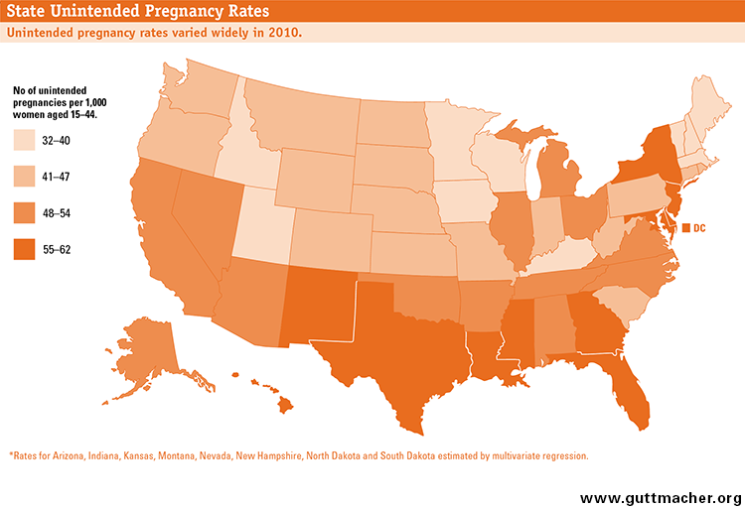

Slide 6
Contraception
A woman who only wants to have two children must use some form of contraception for nearly 3 decades of her life.

Slide 7
Medical Benefits
Use of any method helps prevent high-risk pregnancies
All methods help women space out births
Some methods have non-contraceptive benefits:
Condom use reduces the risk of STDs
Hormonal methods reduce the risk of ovarian and endometrial cancer, ovarian cysts, and painful menstrual cramps/heavy bleeding

Slide 8
Non-Medical Benefits
Individuals: Expanded access to education, work and financial security
Freedom to have sex without a high risk for pregnancy
Families: Increased resources; greater attention and care to each child
Society: Higher productivity, increased gender equality and reduced public spending

Slide 9
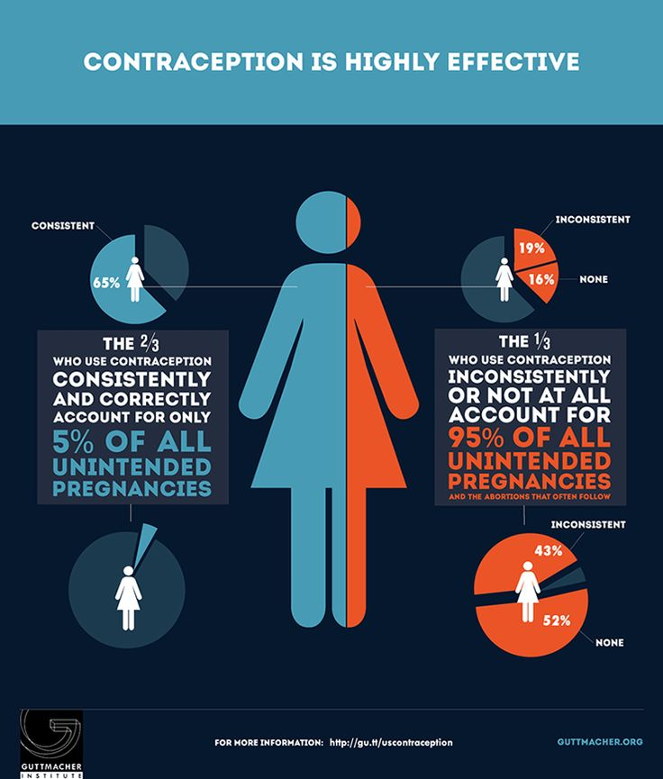

Slide 10
Why do some teens fail to use contraceptives?
They don’t think they are at risk for pregnancy
They have problems obtaining contraceptives (access or affordability)
They see sex as something you don’t plan for – “it just happens
They are ambivalent
They have a partner who prefers not to use contraception
They don’t expect to have sex

Slide 11
Many Men and Women Also need STI Prevention
There are more than 25 different infections spread by sexual activity
More than 65 million people in the United States have and incurable STD/STI
Approximately 19 million new cases of STDs occur each year
50% of sexually active young people will contract an STD before age 25
Of women sexually active last year, 34% were at increased risk because of having multiple partners

Slide 12
What are the challenges for Information & Access?

Slide 13
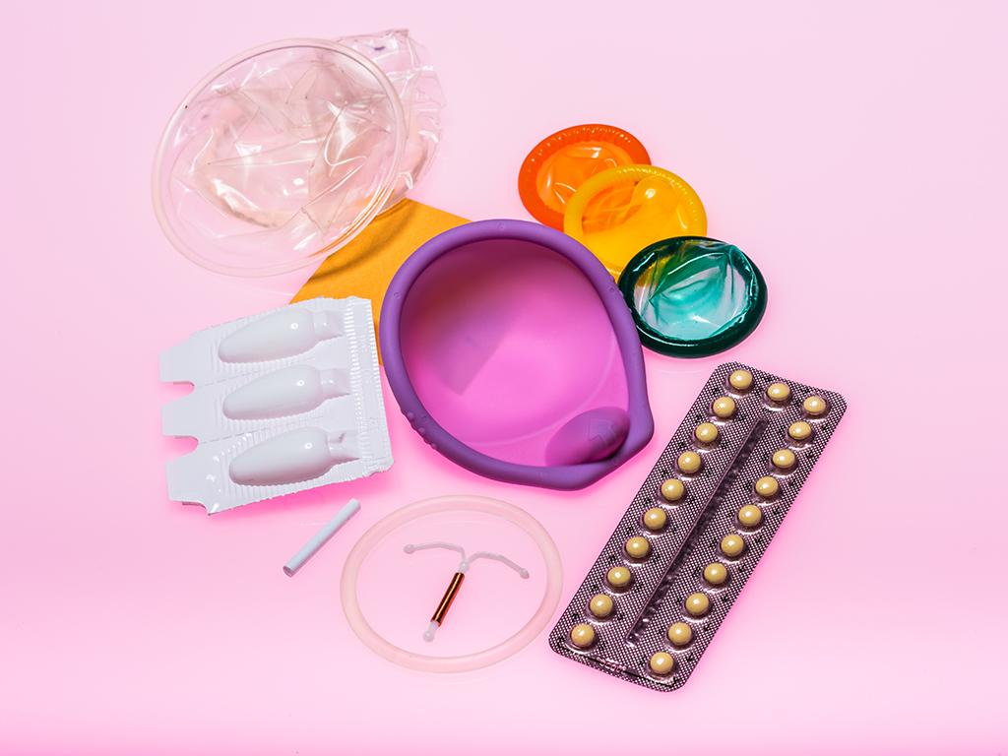
NO method of contraception is 100% effective in preventing pregnancy and Hormonal methods DO NOT reduce STD risk.

Slide 14
True or False:
A user can safely remove the female condom at anytime
Answer True

Slide 15
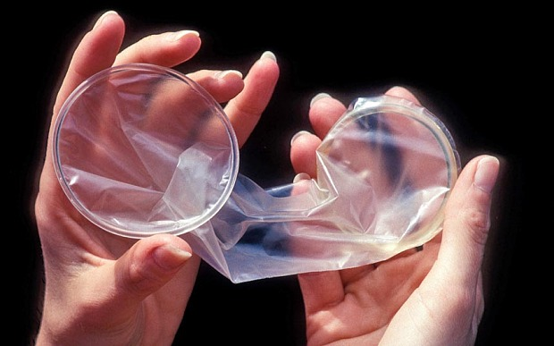
True or False
The inner ring of the female condom contains a small amount, Progestin.
Answer: False

Slide 16
Of course, not all sexually intimate couples need contraception for the purpose of pregnancy risk reduction…

Slide 17
But many couples need STD risk reduction that is achieved by modifying behaviors and by using and appropriate barrier (condoms or a dental dam for oral sex)

Slide 18
As you are aware, some STD’s are transmitted via oral or oral-genital contact.
Thus, the need to cover the genital area – with a “dental dam” or similar material.

