Slide 1
Mental Disorders
Associated Signs & Symptoms

Slide 2
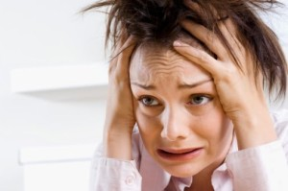
Which Disorder is this?

Slide 3
Generalized Anxiety Disorder
Symptoms: muscle tension, physical weakness, poor memory, fear or confusion, inability to relax, constant worry, upset stomach, poor concentration, shortness of breath
Note: multiple symptoms last over a long period of time & interfere with daily function and life of an individual

Slide 4
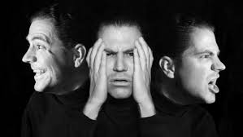
What about this one?

Slide 5
Bipolar Disorder (Manic Depression)
Symptoms: constantly changing moods (extreme Highs and lows), lack of interest in things, and inability to enjoy normally pleasing activities
Note: Often due to hormonal imbalances
Notes:
we are NOT talking about being happy one minute and mad the next --

Slide 6
And this one?

Slide 7
Panic Disorder
Symptoms: Experience feelings of terror that strike suddenly and often. A form of anxiety often times accompanies this disorder. Individual can faint, feel dizzy, feel sweaty, and even get chills.
Note: the individual often times feels a loss of control. Episodes can occur randomly throughout the day depending on ones triggers

Slide 8
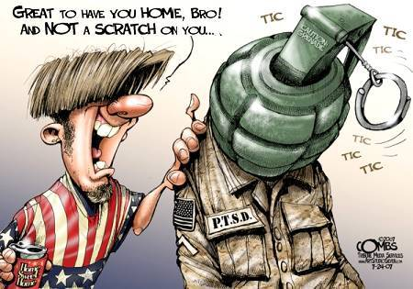
Take a Guess!

Slide 9
POST Traumatic Stress Disorder (PTSD)
Symptoms: reoccurring vivid memories/flashbacks of a traumatic events. Individual often times can’t decipher between the flashback and reality. Individual avoids thoughts or anything that might remind them of the traumatic event. Irritability, outbursts of anger, easily startled, and difficulty with sleeping
Note: combat veterans are more common but they aren’t the only victims nor do all veterans suffer from PTSD

Slide 10
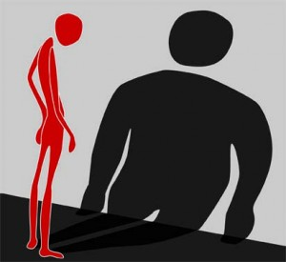
And this one?

Slide 11
Eating Disorders
Refusal to maintain bodyweight that is consistent with his/her build, age, and height due to an intense or overwhelming feeling an fear of gaining weight or becoming overweight. Body image is a primary factor that determines how the individual feels about themselves.
Anorexia- extreme restriction of food intake
Bulimia- self-induced vomiting/misuse of laxatives to rid the body of food
Binge eating

Slide 12
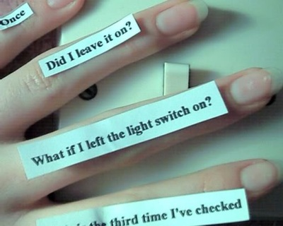
What about this one?

Slide 13
Obsessive-Compulsive Disorder (OCD)
Symptoms: Individual feels compelled to repeat certain actions/routines/impulses to prevent a dreaded situation
Note: these behaviors are usually excessive and unnecessary in preventing the feared situation
example- feeling extreme anxiety if items aren’t organized in a certain order

