Slide 1
Food and Your Heart
“What you eat and your heart health are tightly linked together.”

Slide 2
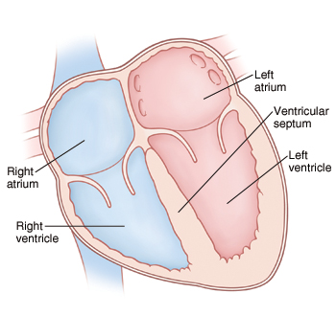
The Heart
The heart is the organ that pumps blood and oxygen throughout the body.
The heart is divided into 4 chambers that blood flows through.
2 Ventricles
2 Atria
In the blood we’ll find:
Oxygen
Nutrients

Slide 3
The Heart: Arteries
To transport the oxygen and nutrients to our body blood flows through arteries.
Arteries are the small muscular vessels that deliver blood from the heart to the tissues of the body.

Slide 4
Who are the Main Players?
There are many substances that impact your heart health
Fat- Increase cholesterol levels and makes it harder for your organs to function (think about insulation)
Cholesterol- Overtime clogs your arteries and restricts blood flow
Sodium-Overtime increases blood pressure

Slide 5
Diseases and Disorders
Hypertension
Stroke
Atherosclerosis
Type 2 Diabetes
Congestive Heart Failure
Angina
Some ethnic and cultural groups are at higher risk for developing these diet and heart related disorders than other ethnicities.
Why?

Slide 6
Continued…
One’s family and cultural background is linked to the food they eat which in turn impacts their heart health.
What can we ALL do to reduce our risk for heart disease?
Monitor your “Main Players”
Increase Physical Activity and Exercise Level

