Slide 1
Bell Ringer- Matching Activity
Over-The-Counter Medicine
Drug Misuse
Prescription Medicine
Drug Abuse
Drug use which is physically, socially, legally, or emotionally harmful to self or others.
Medicines and remedies which may be purchased without a doctor’s order.
Using a drug other than its intended purpose or by someone other than the person for which it was intended
Drug products which may have greater side effects and therefore need to be prescribed by a physician

Slide 2
Predicting the Consequences of Abuse of OTC Medicines

Slide 3
Follow-Up Questions
What is the difference between prescription and OTC medicine?
What are some OTC medicines a family might keep in their medicine cabinet?
What are the benefits provided by prescription and OTC drugs?
Do both OTC and prescription drugs have potential risks? What are examples?

Slide 4
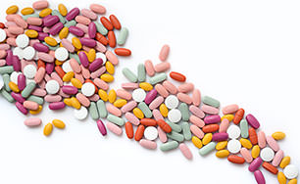
“No drug is perfectly safe. A drug powerful enough to do good is powerful enough to do harm.”
-Martin Minty

Slide 5
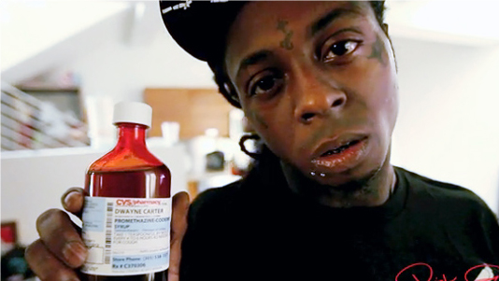
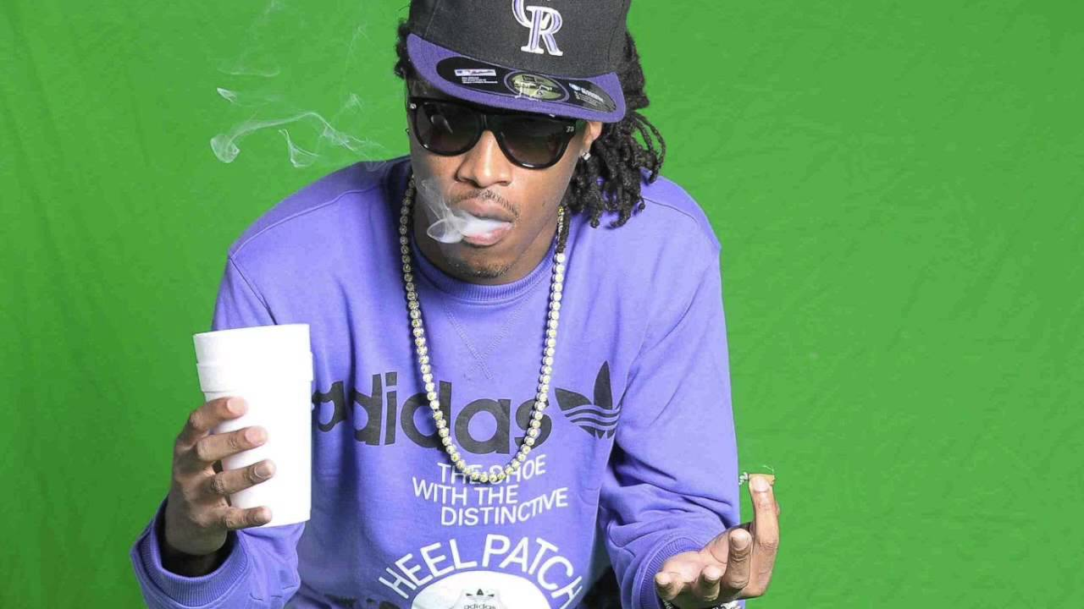
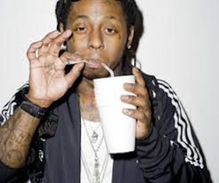
Examples
What is DXM?
Dextromethorphan- Commonly used to treat cough, cold and flu symptoms
Codeine?
Powerful opioid medication used for pain and cough, flu symptoms
Made popular by rap artists
Slang Terms (Lean, sizzurp, dirty Sprite)

Slide 6
If You Don’t Have a Label of Your Own
These are some Common Examples that you can research
Benadryl
NyQuil
Prilosec OTC
Ibuprofen
Pepto-Bismol
Bayer
Excedrin
Diet Pills
Laxatives

