Slide 1
The Dealing with Peer Pressure & Using Refusal Skills
“Come on, every body is doing it!”
Ms. Harris
Ms. McCoy
Mr. Garrison
Mr. Bee

Slide 2
Is Peer Pressure ok?

Slide 3
Statement of Objective
Students will be able to distinguish between positive and negative influences, analyze the consequences of peer pressure, and identify at least 3 refusal skills.

Slide 4
Direct Peer Pressure
Indirect Peer Pressure
Teasing
Persuasion
Explanations
Put-downs
Threats
Bribery
TV
Radio
Advertising
Role Models
Popular People
Famous People

Slide 5
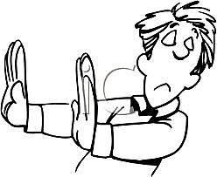
Refusal Skills
Reverse the pressure
Give a reason
Ignore the request or pressure
Say “no thanks”
Say no, and mean it!
Continue to keep saying no

Slide 6
Refusal Skills
Make a joke out of it
Make an excuse
Suggest something else to do
Change the subject
Team up with someone

Slide 7
