Slide 1

Puberty

Slide 2
Warm Up
Create and fill in the following chart:
Changes Both Genders Go Through
Male Changes During Puberty
Female Changes During Puberty
Shoulders broaden
Voice deepens
Appearance of hair on face, underarms and around genitals
Enlargement of testes and penis
Nocturnal Emissions
Growth Spurts
Acne
Emotional changes
Rise in sex hormones
Increase in sweat production
Appearance of hair on underarms and around genitals
Development of the breasts
Widening of the hips and pelvis
Start of ovulation and menstruation
Puberty: The period of human development during which people become able to reproduce

Slide 3
OBJECTIVES
Understand the changes that occur during puberty and adolescence
Summarize the relationship between conception and the menstrual cycle

Slide 4

Physical Changes:
Puberty is the period of human development during which people become able to reproduce.
Adolescence is the time between
puberty and full maturation.
Hormones are chemical substances made and released in one part of the body that cause a change in another part of the body.
The male hormone testosterone and the female hormones estrogen and progesterone are released at the start of puberty.

Slide 5
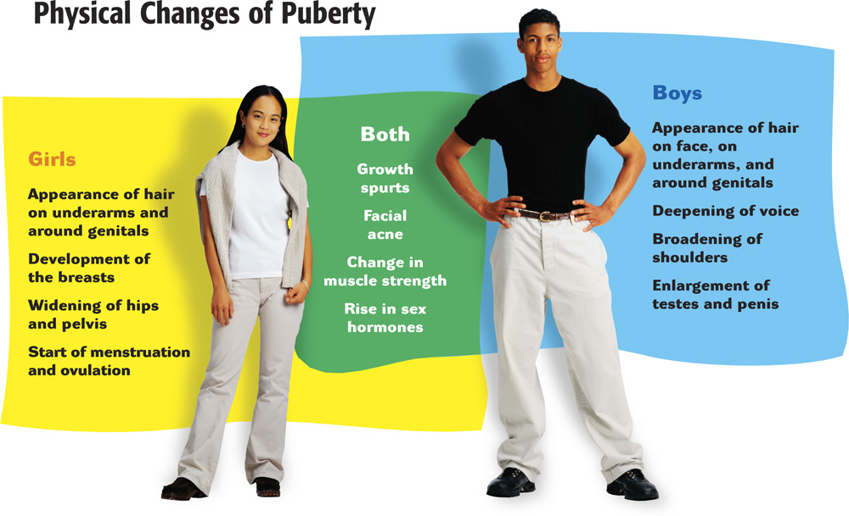

Slide 6

Mental Changes:
A New Way of Thinking~ As adolescence progresses, teens are able to think in a more complex way. They can foresee consequences, make more logical decisions, and view situations from other points of view.

Slide 7

Emotional Changes:
A New Way of Feeling~ New feelings that arise during adolescence may cause teens to feel alone, insecure, and confused.
The process of leaving dependence behind and forming a new identity is complex and sometimes scary. Having conflicting emotions is healthy and normal.
If prolonged periods of sadness or anxiety become overwhelming, seek help from a parent, school counselor or doctor.

Slide 8

Social Changes:
As teens grow older, their parents and others expect more of them.
Relationships with friends change and become more important during adolescence.
You can take more responsibility at home, in friendships, and in other parts of life by:
showing concern for how people are doing
listening to others
encouraging others
getting a job

Slide 9
BRAIN BREAK!!!!
3 MINUTE BRAIN BREAK
FIND 3 DIFFERENT PEOPLE AND TELL THEM ONE THING THAT YOU LEARNED FROM CLASS.
EACH PERSON MUST BE FROM A DIFFERENT TABLE.

Slide 10
So now what….
Now that you have gone through PUBERTY, what is possible?
Do you know the cycle of life?

Slide 11
Group Activity/Competition
PART 1
Match each part or function with the gender
When your group is finished, sit quietly
PART 2
Designate the YOUNGEST person in your group to be the score keeper
Look at the diagrams on the board and tally how many parts or functions you got CORRECT
BOTH: Mucous Membrane, Urethra, Puberty, Genitals, Pubic Hair, Lymph Nodes
FEMALE
MALE

Slide 12
Ovulation, Menstruation, and Conception
The Cycle of Life

Slide 13
The Ovulation-Menstruation Cycle
Many individuals only talk about the MENSTRUATION cycle.
We’ll talk about these events as parts of one cycle.
Menstruation is a more obvious event, but ovulation is a more important event (the capacity to create a human life).

Slide 14
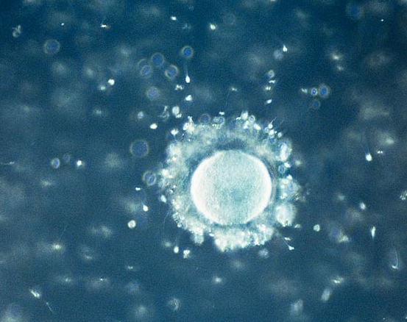
Ovulation and Conception
Ovulation occurs when an ovum (usually just one per cycle) ripens and is released from the ovary Into the fallopian tube.
If the woman has sexual intercourse, the ovum may meet and join with a sperm cell from the man. This is called conception or fertilization.

Slide 15
Conception
The ovum (egg cell) is the size of a grain of salt.
40 – 150 million sperm are released from the male at a time
Only one sperm will fertilize the ovum(egg).

Slide 16
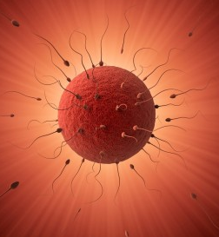
Conception
During sexual intercourse, millions of sperm are released
Only a few hundred make it to the ovum
Only one sperm will penetrate the ovum.

Slide 17
What Happens If Conception Does Occur?
The fertilized ovum (now called a zygote) travels into the uterus and implants in the wall of the uterus.
The zygote develops into a baby to be born approximately nine months later.

Slide 18
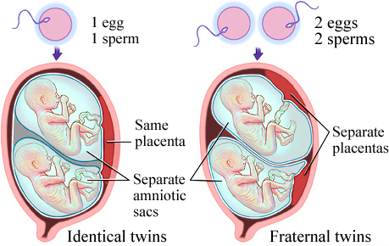
How Do Twins Happen?
With identical twins, one sperm fertilizes one ovum; the zygote splits into two.
With fraternal twins, two ova are released and fertilized by two different sperm and zygotes share the womb during pregnancy.

Slide 19

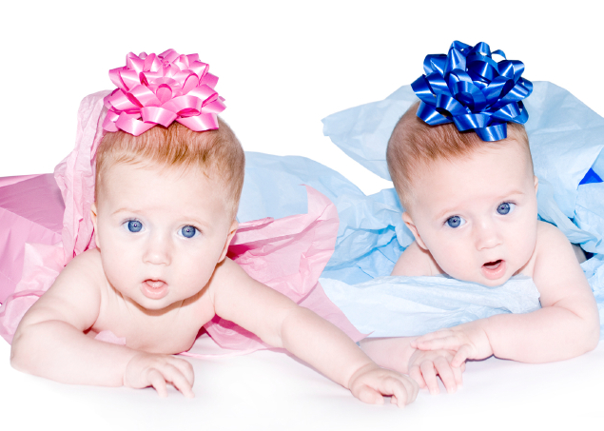
Two Types of Twins
Identical Twins
Fraternal Twins
No more alike than any two siblings; can be a boy and girl
Share same DNA; always two girls or two boys

Slide 20
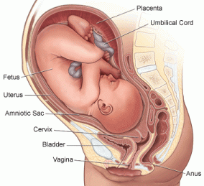
Pregnancy
The zygote develops into a fetus then develops into the baby.
Pregnancy takes about 40 weeks.
Mother needs to eat nutritious food, gain the proper amount of weight, avoid alcohol, tobacco, and drugs, and visit the doctor regularly.

Slide 21
What Happens
When Conception
Does Not Occur?
If the ovum is not fertilized, it will travel from the uterus with menstrual flow or bleeding during the next menstruation. (This is known as the female’s menstrual period)

Slide 22
What is the fluid which leaves the body during menstruation?
In preparation for the possibility of pregnancy, the endometrium (or lining of the uterus) begins to get thicker.
If conception does not occur, the lining thins out and leaves the body.
The sloughing off of the endometrium (or menstrual blood) is a normal process for girls and women during their reproductive years.

Slide 23
Sequence of the O-M Cycle
Explanation
Menstrual flow begins and lasts about 3-7 days. (Bleeding)
Lining of the uterus begins to get thicker.
Ovum is released from one of the ovaries.
Ovum travels down the fallopian tube to uterus; if not fertilized, it dies and passes from body.
Lining of uterus thickens again.
Menstrual flow begins again. (Bleeding)

Slide 24
O-M Cycle: What is Average? What is Normal?
Length of O-M cycle: 28 or 29 days (may be 20 to 35 days)
Ovulation usually occurs 14 days PRIOR to menstruation (may occur earlier, later, or not at all); rarely occurs during menstruation, but it is possible
Length of menstruation: 5 days (may be 3 to 7 days)

Slide 25
Other Factors
Related to Conception
Sperm from males can live an average length of time: 3 days (or shorter: 1 1/2, or longer: 7 days).
Ovum may be viable for several days.
Because a female cannot accurately predict when she will ovulate and a male does not know how long his sperm will live, . . .

Slide 26

A couple cannot predict for certain if pregnancy will or will not happen at any given time based on the calendar alone.

Slide 27
Figuring out Menstrual Cycle and Ovulation Date
Day 1 – first day of the menstrual flow is the most obvious. We will assume the female has a regular 28 day cycle, and March 7th will be the first day.
Count forward 28 days, and determine when the first day of the next cycle will be.
If we count backwards from April 3rd 14 days we can determine the most likely day for ovulation
PARTNER ACTIVITY
Continue to count ahead to determine the next menstrual cycle, and then back to determine the ovulation day. Do this for the entire 6 months on the sheet.
After you are finished and have the correct dates you need to get the teacher to check to make sure it is correct.

Slide 28
Classwork
Read the Female and Male Reproductive System Articles. Take notes and write a ½-1 page summary on the most important things you learned

